Slide 1

POWER LINE COMMUNCATION

Slide 2
CONTENTS
Introduction
Power Line Communication System
Types of PLC Architecture
PLC Basic Network Elements
PLC Channel
Applications
Advantages
Disadvantages
Conclusion

Slide 3
INTRODUCTION
Power Line Communications (PLC), also known as Broadband Power Line Access (BPL), power line digital subscriber line (PDSL) is the latest technology to provide broadband Internet access through existing house wiring.
The usage of the power grid for control, maintenance and charging purposes by the utility commodities.
The deregulation of electricity utilities, which have added new dimensions to the potential application of the electricity infrastructure.

Slide 4
POWER LINE COMMUNICATION SYSTEMS
Power Supply Networks:
High Voltage (110-380kV) networks : Connnect the power stations with large supply regions or big customers.
Long Distances, power exchange with in a continent.
Overhead supply cables.
Medium Voltage(10-30kV) networks : Supplies larger areas,cities and big indutrial or commercial customers.
Overhead supply cables and underground networks.
Low-Voltage(230V in Germany) networks: Supply the end users either as individual cutomers or ass single users of a bigger customer.
Overhead and underground cables.

Slide 5
Types of PLC Architecture
There are two types of architecture,they are
1.Narrow Band PLC
2.Broard Band PLC

Slide 6
Narrowband PLC
A Band for power supply Utilities, e.g. Energy related services.
B and C Band for private uses, e.g. For building and home automation.
Data Rate upto few thousands bits per second.
Maximum distance covers upto 1 k.m.
Needs repeater for long distance technique.

Slide 7
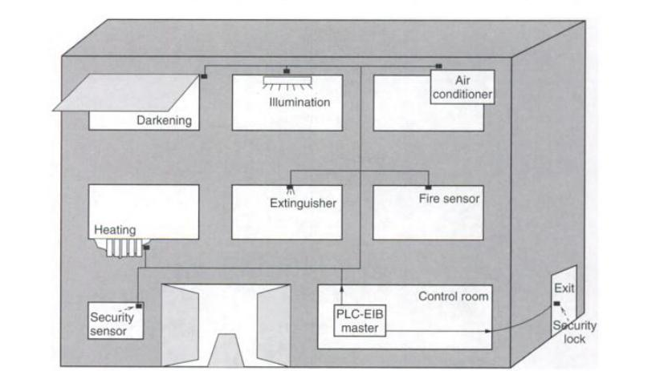
Structure of an autonomous system using narrowband PLC

Slide 8
Broadband PLC
Broadband PLC Systems provide significantly higher data rates(more than 2 Mbps) than narrowband PLC Systems.
Broadband PLC networks offers the realization of more sophosticated telecommunication services.
A wider frequency spectrum is needed (up to 30 MHz) due to EMC(Eletromegnatic Compatibility), than it provides with in the CENELEC bands.
On the otherhand, PLC network acts as an attenna becomming a noise source for other communication systems, e.g, radio services.
PLC has to operate with a limited-signal power, which decrease their performance(data rates, distances).

Slide 9
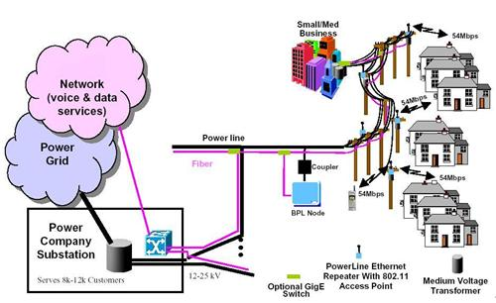
Fig:Power-Line Broadband access Architecture

Slide 10
PLC BASIC NETWORK ELEMENTS
The communication signal has to be converted into a form that allows the transmission via electrical networks
Following two devices exits in every PLC access network:
PLC modem
PLC Base Station

Slide 11
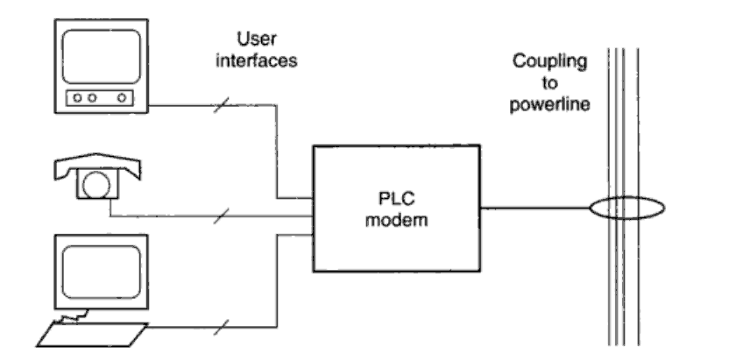
PLC Modem
A PLC modem connects standard communication equipment, used by the subcribers, to a powerline transmission medium.
Functionality of the physical layer i.e. Modulation and Coding.
Functionaliy of the Data Link Layer including MAC and LLC.
Fig: PLC Modem

Slide 12
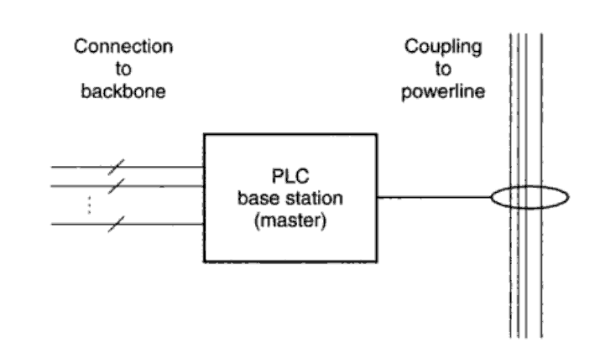
PLC Base/Master station
A PLC base station connects a PLC access system to its backbone network.
Provides multiple network communication interfaces, such as xDSL, Synchronous Digital Hierarchy(SDH) for connection with a high-speed network, WLL for wireless interconnection and so on.
fig: PLC Base Station

Slide 13
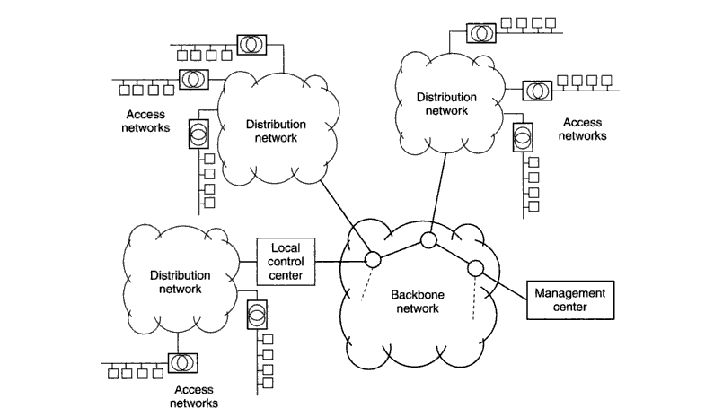
Fig:PLC Network Management

Slide 14
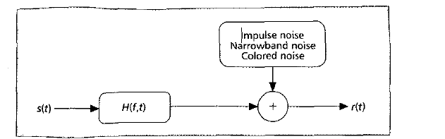
THE PLC CHANNEL
Power lines constitute a rather challenging medium for data transmission. Varying impedance, considerable noise, and high attenuation are the main issues.
Transmission environment for PLC is more complex as that of common mobile communication.
fig: A Simple Channel for PLC
H (f,t)

Slide 15
APPLICATIONS
Automatic meter reading
Home network and internet access
Transmitting radio programs
Industrial applications
Communication and signal processing

Slide 16
ADVANTAGES
No additional wire network .
Low cost.
Existing infrastructure in rural areas.
The cost of installation is lower than other communication system.
For remote measuring and control task high, medium and low voltage supply have been used.
High data transfer rate, up to a few hundreds of Mbps.

Slide 17
DISADVANTAGES
Data attenuation
Significant potential interference.
Noise

Slide 18
CONCLUSION
In spite of harsh environment of Power line channel the OFDM technique proved it’s ability to deliver data with high data rates , low error rate and we can improve the security environment in PLC networks by applying reliable authentication and encryption methods.

Slide 19

ANY QURIES

Slide 20


